Slide 1
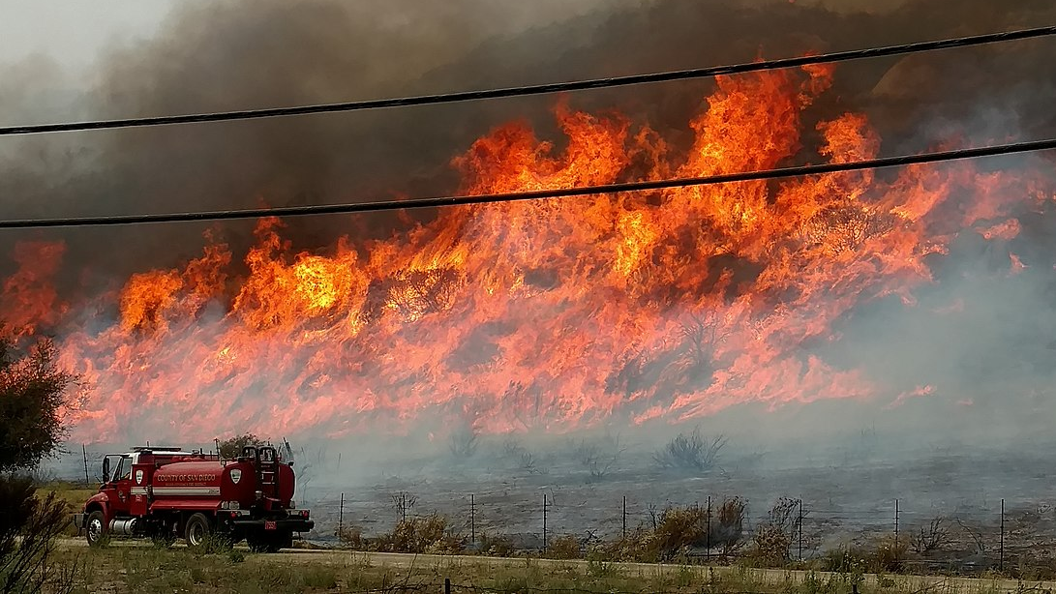
Fire Detection and Localization using Surveillance Camera
Dheeraj Reddy | 100811270 | - Tech lead
Purnima Yadav | 100800499
Ayush Parolia | 100799278
Ramesh Krishna | 100766763

Slide 2
Model preparation
A study is done between various object detection models like Fast-RCNN, SSD and YOLO
YoloV4 model architecture is chosen as it is super fast compared to other architectures and highly efficient, and is widely chosen for live detection of objects.
The process for model training is all set and working, which is also currently tested for smaller dataset.

Slide 3
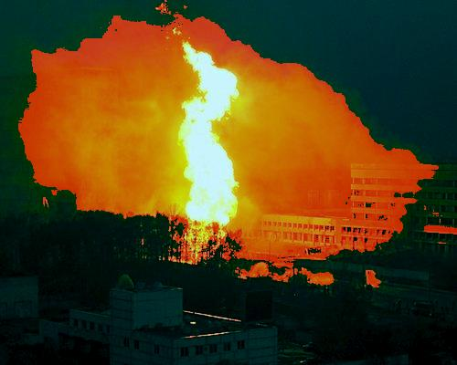
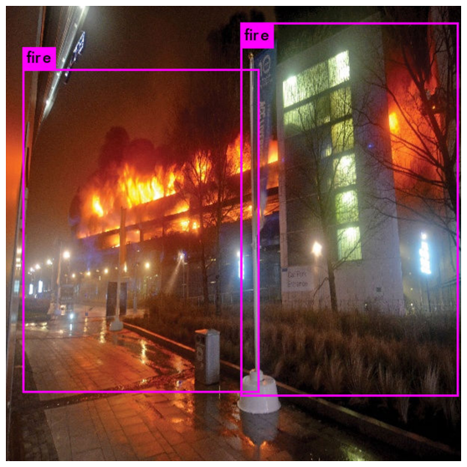
Dataset preparation
The datasets consists of different images and videos of fire.
Major challenge is to annotate the images to pass into to the yolo model.
Currently the model is trained on 200 annotated images.
Target is to prepare data and train on atleast 5000 images
Data pre-processing in progress.

